Slide 1
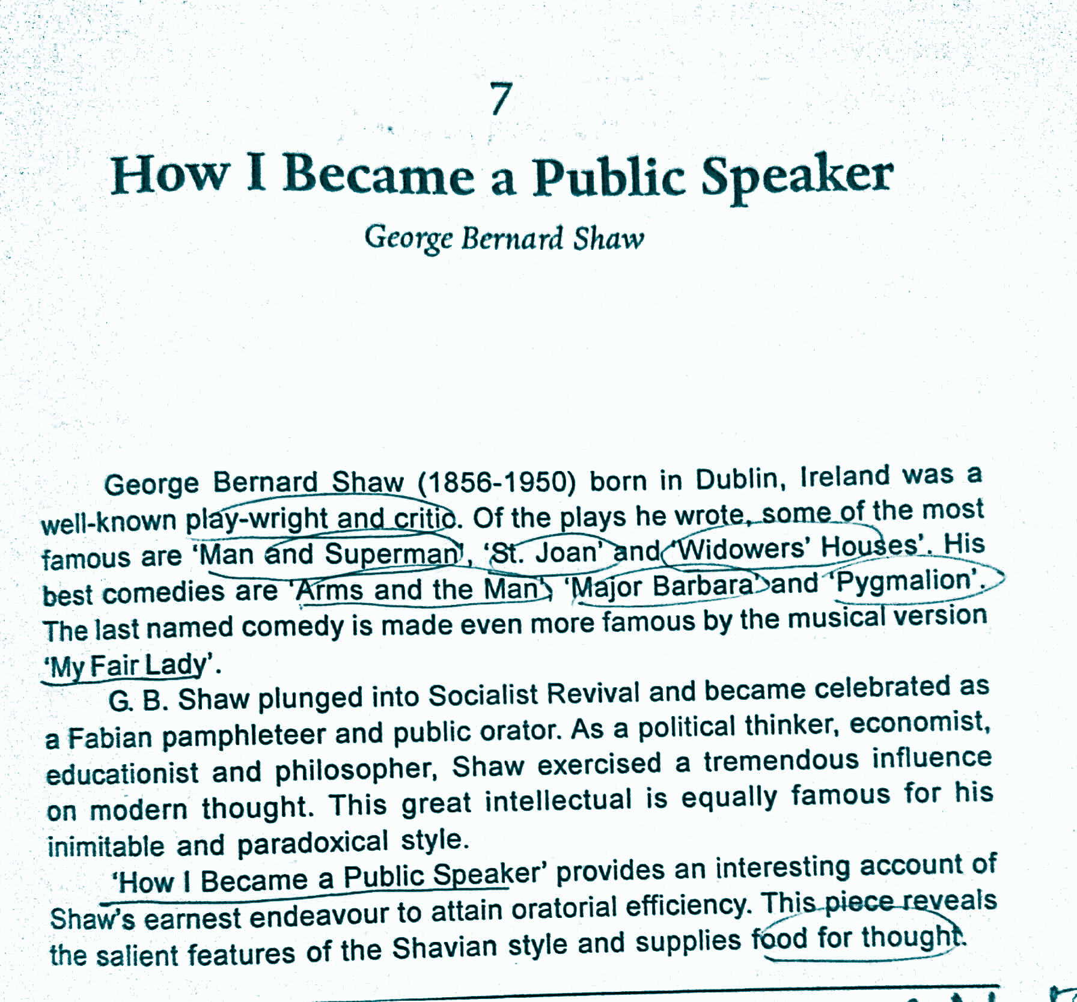
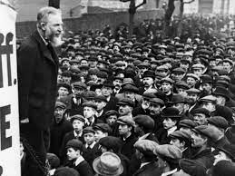
How I Become a Public Speaker
By George Bernard Shaw

Slide 2
I carried out this resolution.
Lecky: friend
Zetetical meeting : meeting for debate
air of impudence: (n) arrogant
an arrnt coward
self conscious to a heartbreaking degree : nervous
Debate
resolve: decide
going under fire: criticise
ghastly practice : unpleasant, shocking
invariably: never changing
I carried out this resolution.
I resolved my method.
My heart used to beat as painfully as a recruit’s going under fire for the first time.
I could not collect myself to decipher a word.
The Four or five points that were my pretext for this ghastly practice, I invariably forgot the best.

Slide 3
At the third meeting I was asked to take the Chair .
Good Public Speaker:
Well Read
Economics
History Books
Social Leaders/Thinkers
Current Affairs
Politics
Religions and their Principles
-I consented as off handedly as if I were the speaker of the House of Commons.
(without thinking seriously, immediately)
- Shaw’s hand shook with terror at time of signing the minutes of the previous meeting.
- But Shaw gave good remarks as Chairman of the meeting.
He was ignorant of Economics but in his boyhood he read -
Mill on Liberty and on Representative Government.
Irish Land Question
Darwin, Tindall and George Eliot.

Slide 4
I persevered doggedly.
F. J. Furnivall : a distinguished scholar
Stopford Brooke: an eminent scholar, author of many books.
“My excessive nervousness soon wore off”.
-I haunted all the meetings in London where debates followed lectures.
-I spoke in streets, in parks, at demonstrations, anywhere and everywhere possible.
Shaw joined:
-literary evenings in University College
New Shakespeare Society under F. J. Furnivall
Bedford Debating Society founded by Stopford Brook

Slide 5
I soon became sufficiently known as a Socialist orator.
Socialism: (samazvad) set of belief which states all people are equal and should share equally country’s property.
Extemporize : to speak or perform without any preparation. (Here) Without consulting notes.
After lots of practice and study, Shaw could extemporize.
-no further need to seek -- I was myself sought.
-This began when I accepted an invitation from Radical Club at Woolwich.
I were to lecture on Socialism for an hour.
Writing would be impossible for want of time.
I must extemporize.
The Lecture was called Thieves.
I spoke for an hour easily.
And from that time extemporized easily.

Slide 6
This went on for about twelve years… One of my best Speeches delivered
-I sermonised on Socialism at least three times a fortnight.
- I preached whenever and wherever I was asked.
-It was first come first served for me.
The places where Shaw delivered speeches are: a street corner, a public-house parlour, a market place, the Economic Sections of British Associations , the city temple, drawing rooms.
My audience varied from ten to thousands.
I expected opposition but got hardly any.
-
One of my best speeches was delivered in Hyde Park in torrents of rain to six policemen, sent to watch me, plus only the secretary of the society that had asked me to speak, who held an umbrella over me. I made up my mind to interest those policemen though, as they were on duty to listen to me, their usual practice, after being convinced that I was harmless, was to pay no further attention. I entertained them for more than an hour. I can still see their waterproof caps shining in the rain when I shut my eyes.

Slide 7
G. B. Shaw always lectured on Controversial Politics and religion . His fees was railway ticket (third class).
-I always replied that I never lectured on anything but Controversial Politics and religion. I was credited with the usual fee and expenses and gave it back to the society as donation. At the elections of 1892, I was making a speech at Town Hall of Dover. A man rose and called G. G. Shaw a professional agitator hired from London. Shaw offered to sell his emoluments for $5, $4 even to six pence. Then declared that he was there at his own expense. | Once in St. James’s Hall, London Shaw was speaking on Women’s Suffrage. At that time a group of opposition with their hostile and excitable leader entered the Hall. As they outnumbered they carried an amendment and broke up the meeting. Shaw demanded a hearing which granted and Shaw gave again a powerful speech. Shaw writes, “No harm was done, nor any blow was struck, but the papers next morning described a scene of violence and destruction that left nothing to be desired by the most sanguinary schoolboy. | Never Resign Shaw says that his public Speaking qualified him to do political work. He tells us about the habit of famous writers as they use to resign whenever they faced opposition. He calls their habit Bohemian Anarchism. (Unconventional way of life) Shaw followed them initially and later decided Never to Resign and face opposition.

Slide 8
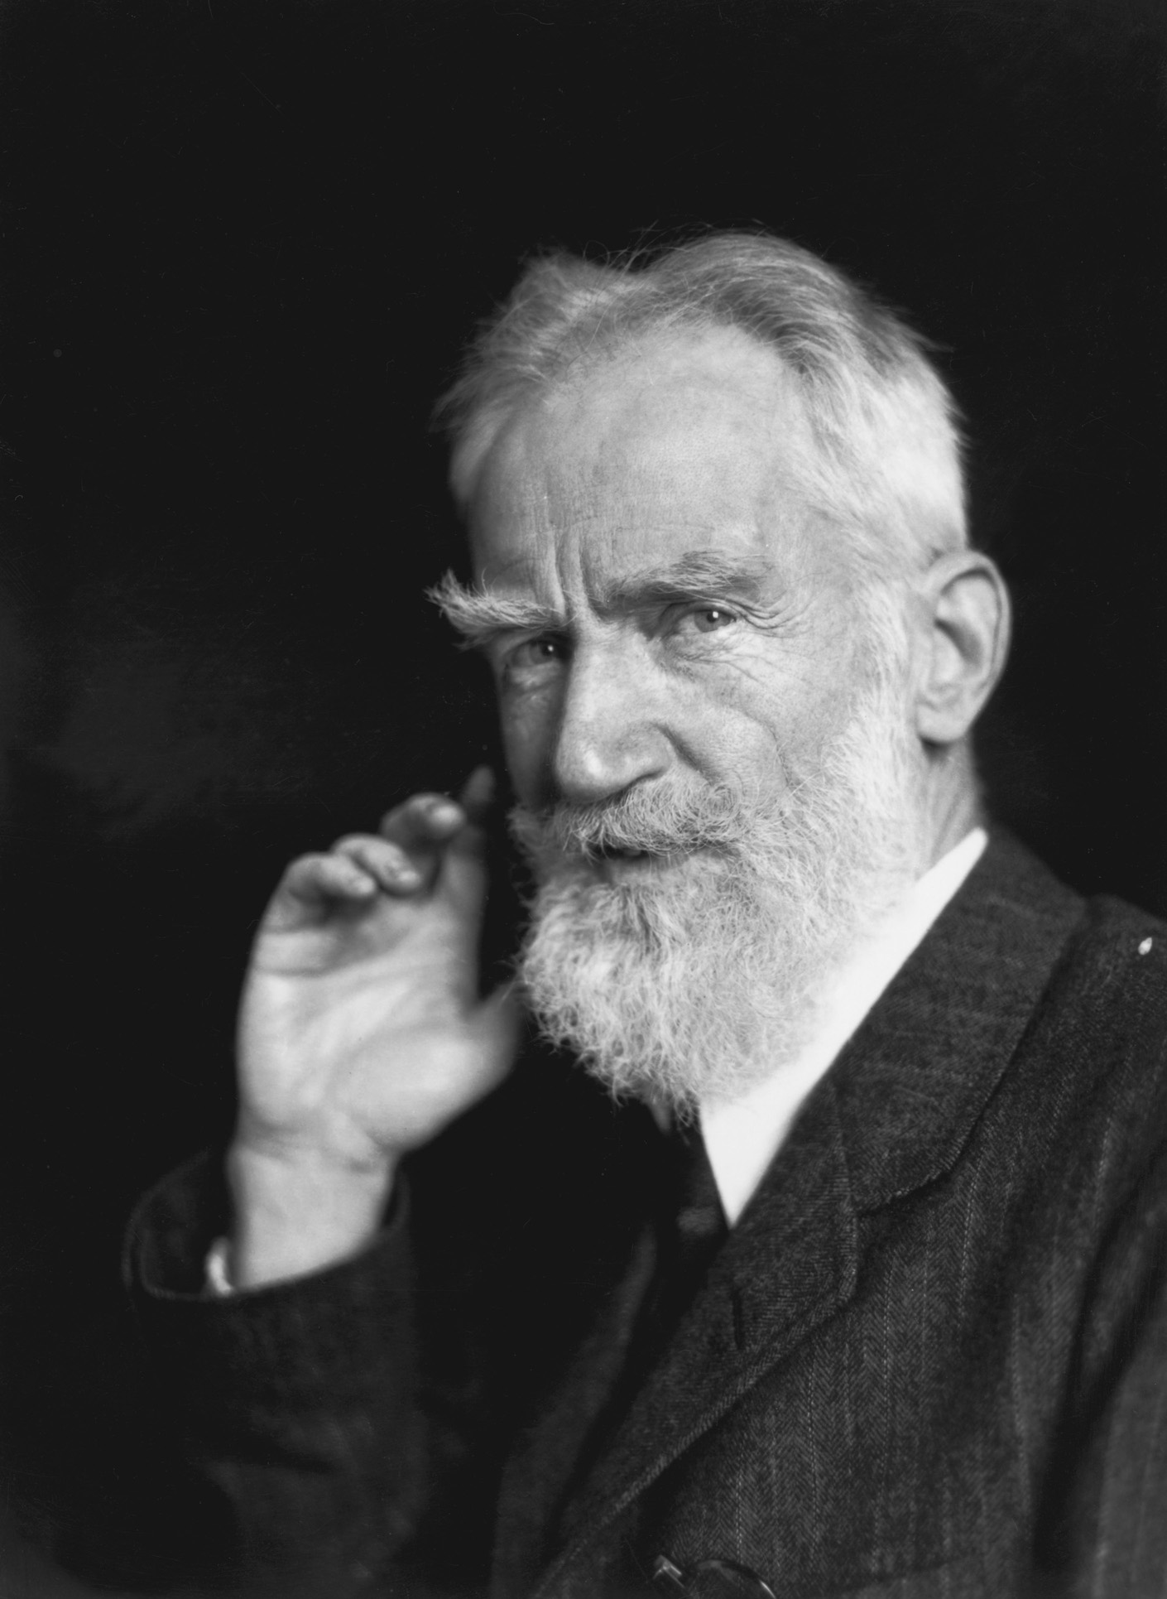
Suggestion to Incipient Orators
Lack of committee training and platform technique
disables Even most gifted thinkers for instance
H. G. Wells (Novelist)
Practice alone : With practice one can acquire all
Required skills.
Good Pronunciation: Training by phonetically
competent teacher
G. B. Shaw took final retirement from personal
Performances in 1941, at the of 85th year.

